Slide 1
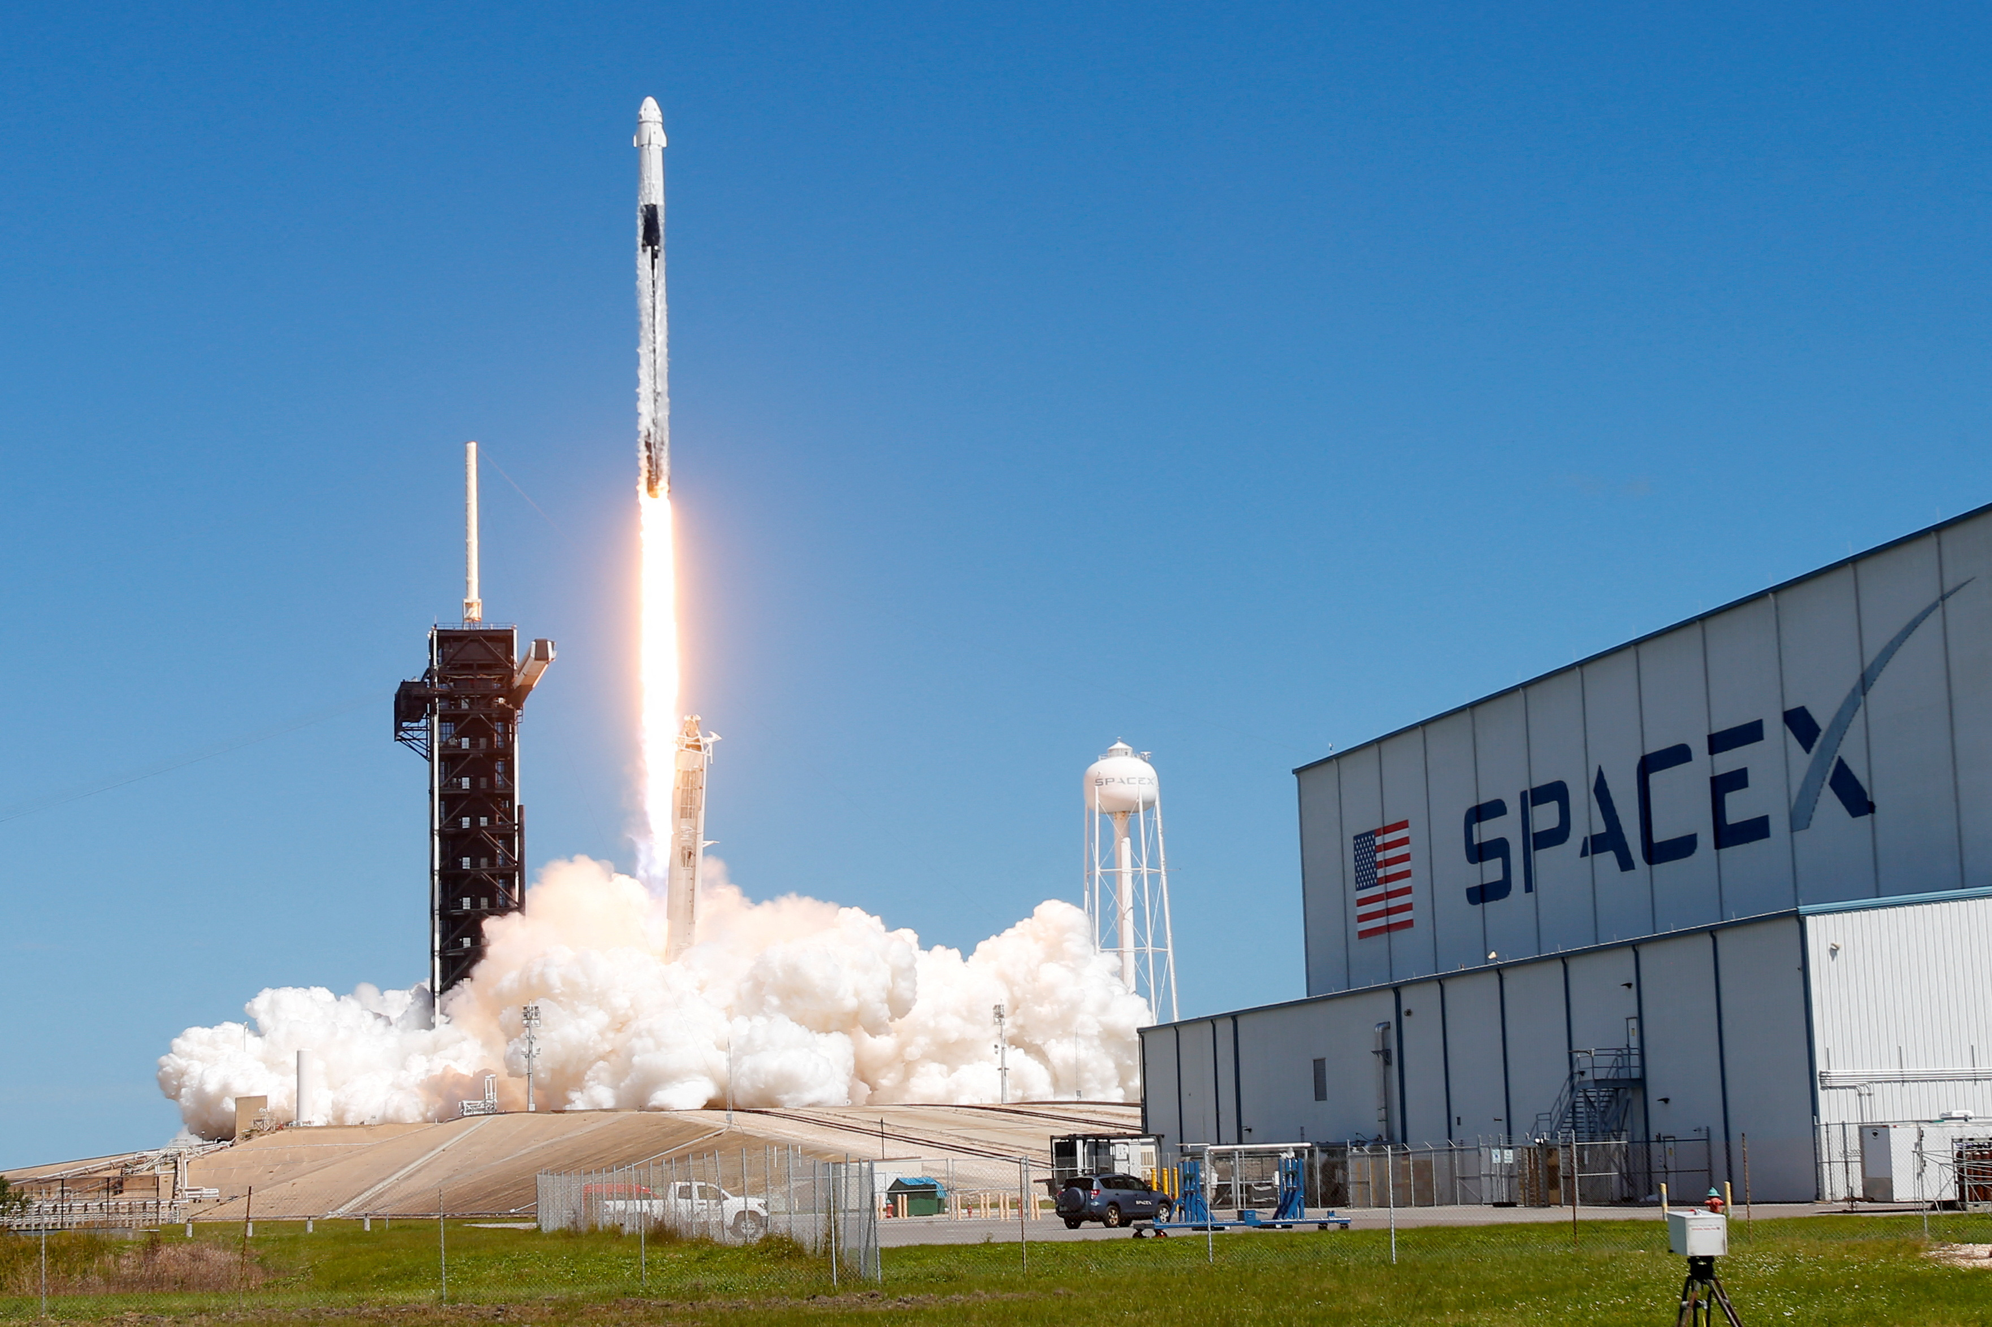
Presentation On Space X With Data Science
Amrik Ghosh
02-04-2023

Slide 2
Outline
Executive Summary
Introduction
Methodology
Results
Conclusion
Appendix

Slide 3
Executive Summary
Summary of Methodologies
Data Collection
Data Wrangling
EDA with Data Visualization
EDA with SQL
Building an interactive map with Folium
Building a Dashboard with Plotly Dash
Predictive Analysis ( Classification )
Summary of all Results
EDA Results
Interactive Analysis
Predictive Analysis

Slide 4
Introduction
Project Background and Context
Falcon 9 rocket launches of Space X advertises on its website, with a cost of 62 million dollars while other providers cost upward of 165 million dollars each. Space X saves more since it can reuse the first stage.
Problems of this Project
This project task is for predicting the first stage of Falcon 9 rocket will land Successfully.

Slide 5

Part 1
Methodology

Slide 6
Methodology
Executive Summary
Data Collection Methodology:
SpaceX Rest API
Web scrapping from Wikipedia
Perform data wrangling
One hot Encoding data fields for Machine Learning and data cleaning of null values and irrelevant columns.
Perform EDA using SQL & Visualization
Using Folium and Plotly Dash performing visual analytics.
Predictive Analysis using Classification Models
LR, KNN, SVM, DT models

Slide 7
Data Collection
The Following datasets was collected:
SpaceX launch data from REST API
Rocket Used, payload delivered, launch specifications, landing specifications & landing outcome.
api.spacexdata.com/v4/ URL used.
Web Scrapping Wikipedia using BeautifulSoup.

Slide 8
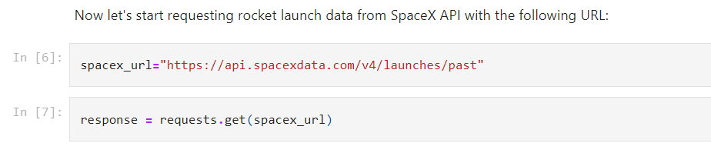
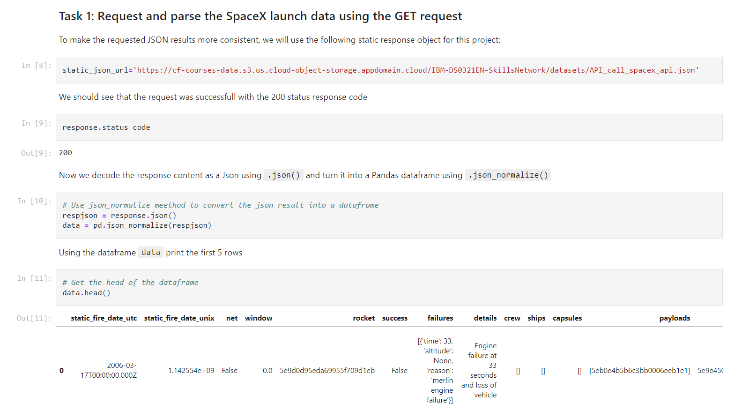
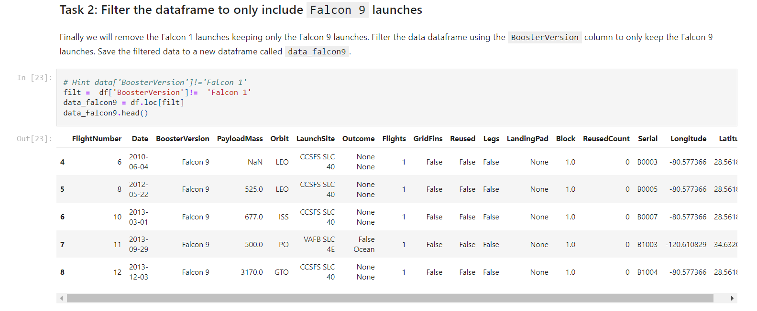
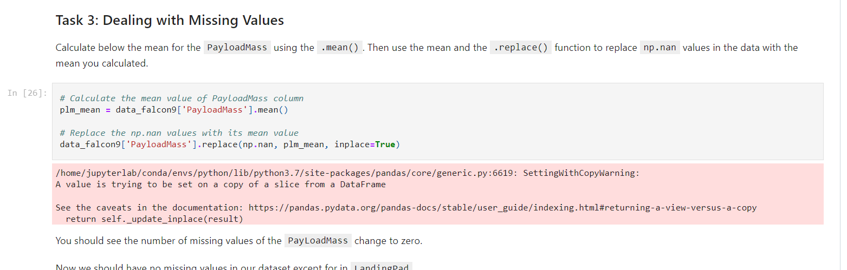
Data Collection – SpaceX API
https://github.com/amrik-mark42/Final-Presentation/blob/main/1.%20jupyter-labs-spacex-data-collection-api.ipynb

Slide 9
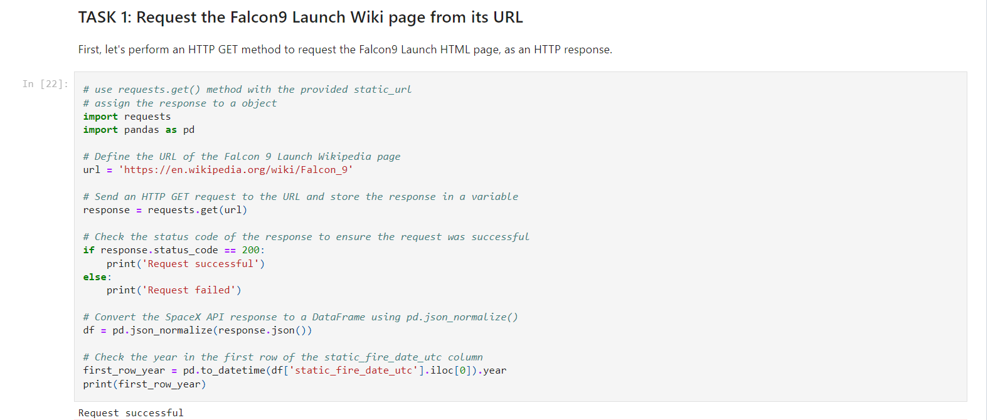
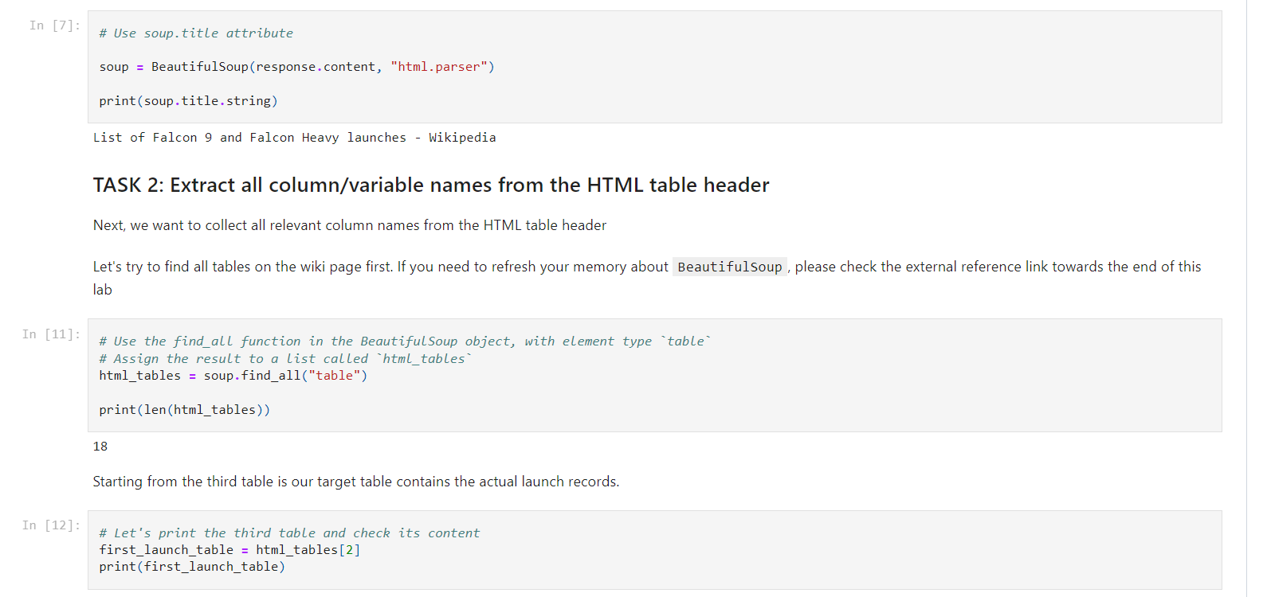
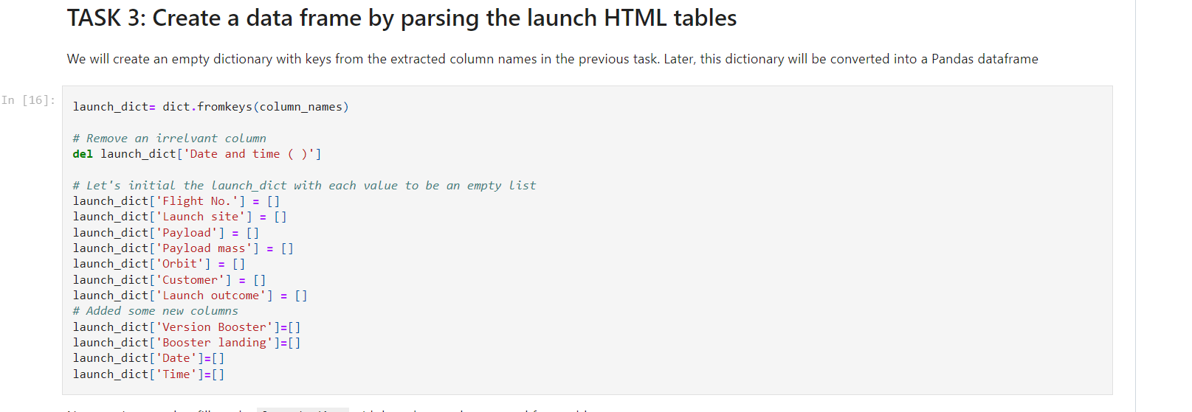
Data Collection - Scraping
https://github.com/amrik-mark42/Final-Presentation/blob/main/2.%20jupyter-labs-webscraping.ipynb

Slide 10
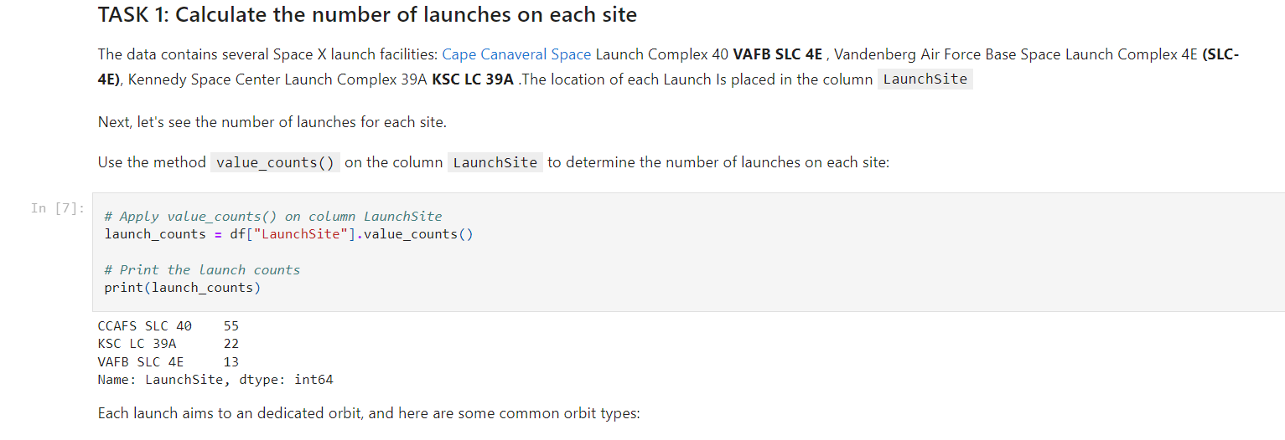
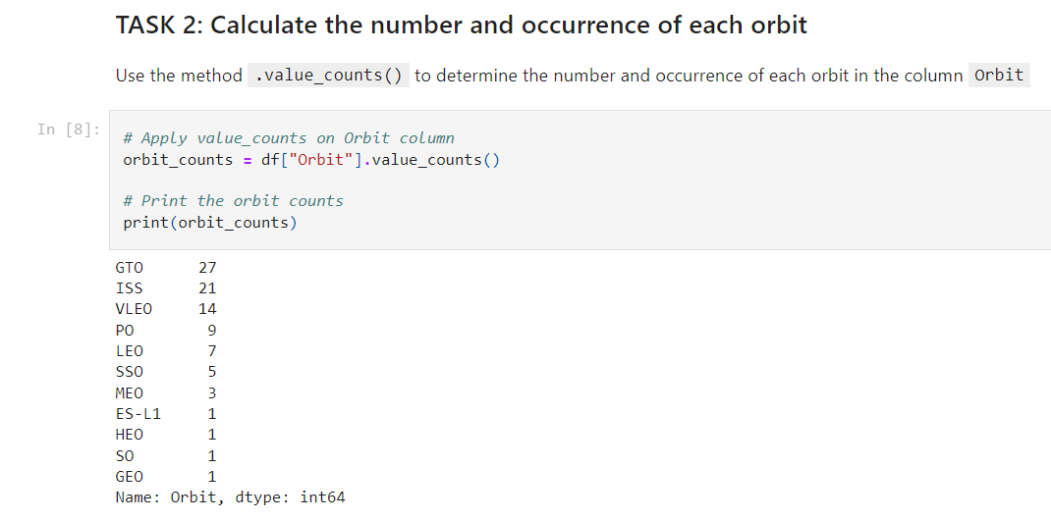
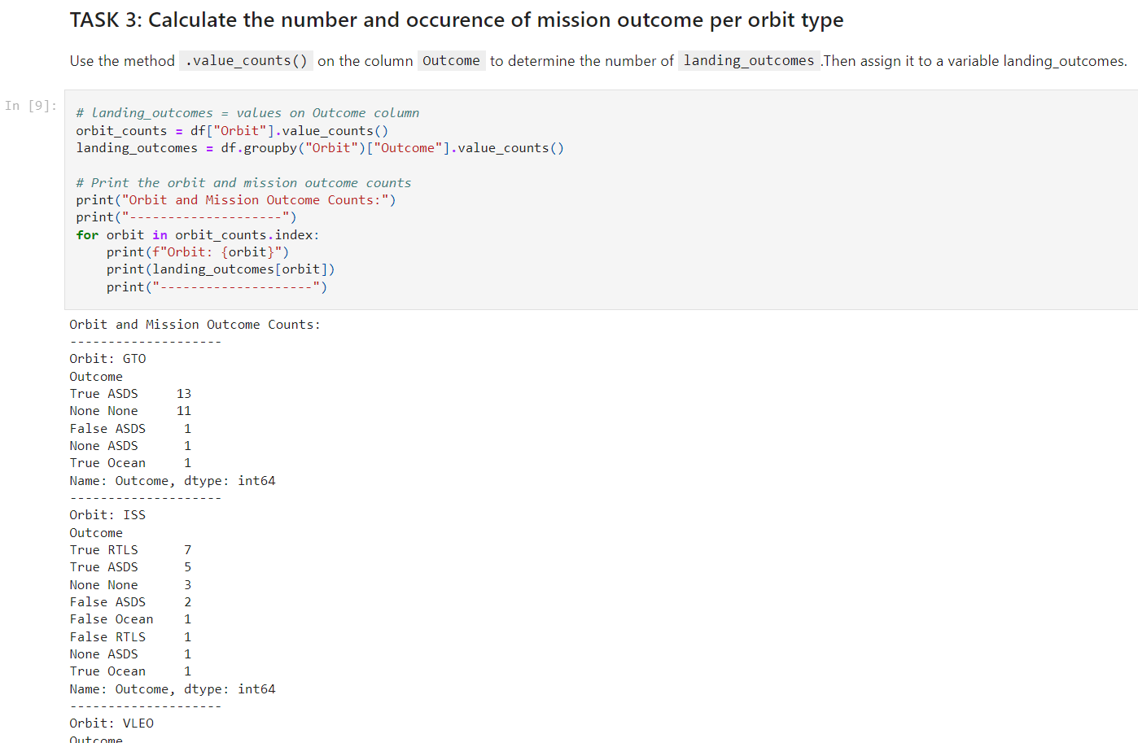
Data Wrangling
https://github.com/amrik-mark42/Final-Presentation/blob/main/3.%20jupyter-spacex-data_wrangling_jupyterlite.jupyterlite.ipynb

Slide 11
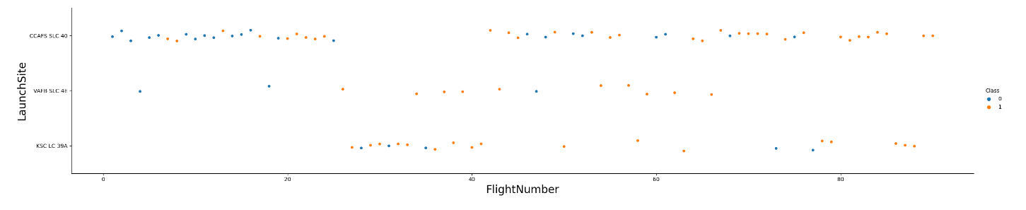
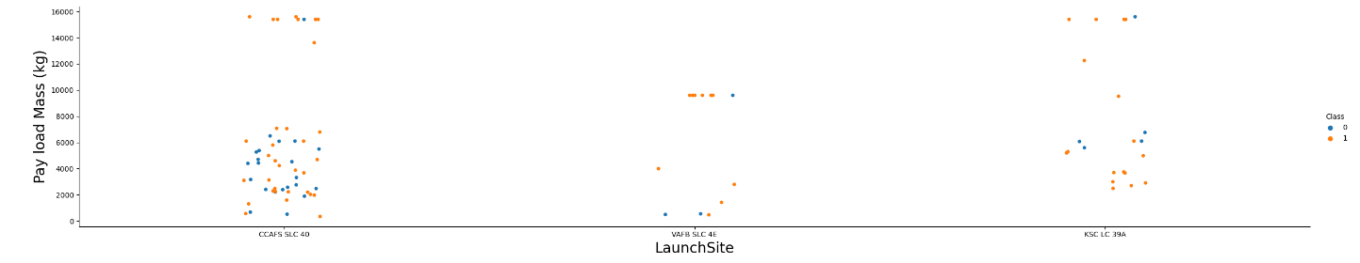
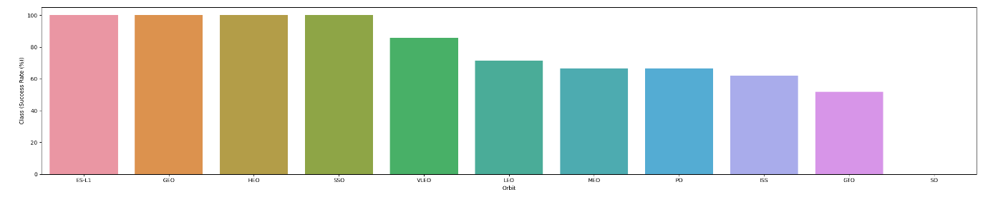
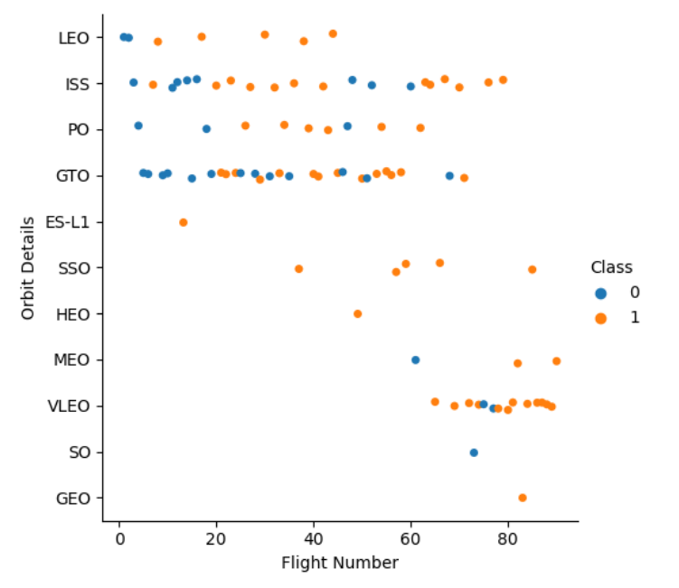
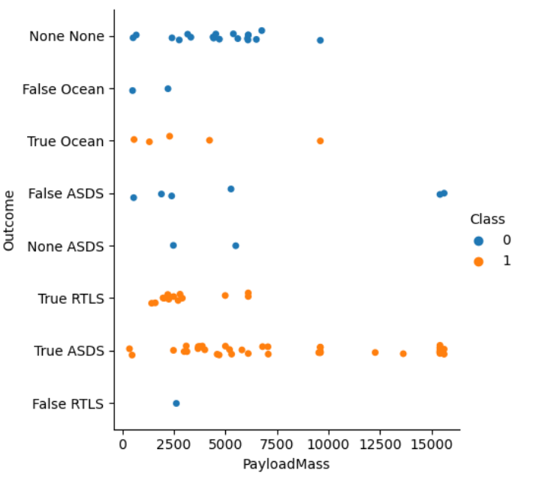
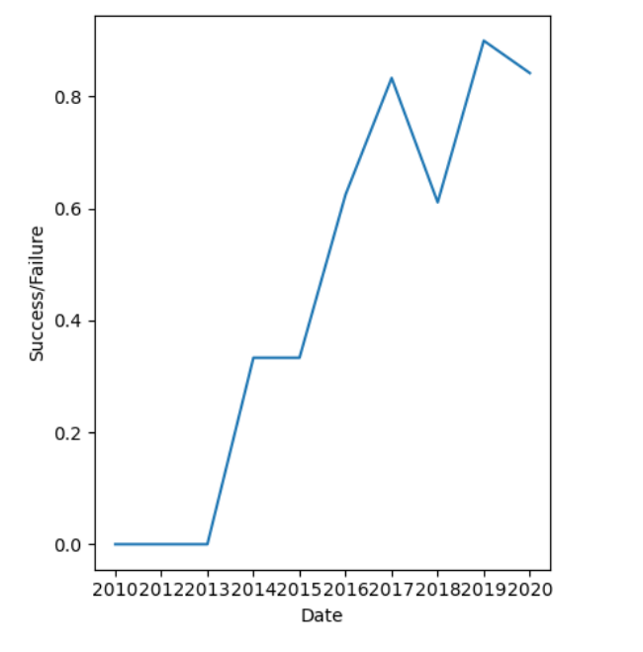
EDA with Data Visualization
https://github.com/amrik-mark42/Final-Presentation/blob/main/5.%20jupyter-labs-eda-dataviz.ipynb.jupyterlite.ipynb

Slide 12
EDA with SQL
SQL queries performed include:
Displaying the names of the unique launch sites in the space mission
Displaying 5 records where launch sites begin with the string ‘ KSC ‘
Displaying the total payload mass carried by boosters launched by NASA.
Displaying average payload mass carried by booster version F9 v1.1
Listing the date where the successful landing outcome in drone ship was achieved.
Listing the names of the boosters which have success in ground pad and have payload mass greater than 4000 but less than 6000.
Listing the total number of successful and failure mission outcomes.
Listing the names of the booster_versions which have carried maximum payload mass.
Listing the records which will display the month names, successful landing outcomes in ground pad, booster versions, launch_site for the months in year 2017
Ranking the count of successful landing outcomes in descending order.
https://github.com/amrik-mark42/Final-Presentation/blob/main/4.%20jupyter-labs-eda-sql-coursera_sqllite.ipynb

Slide 13
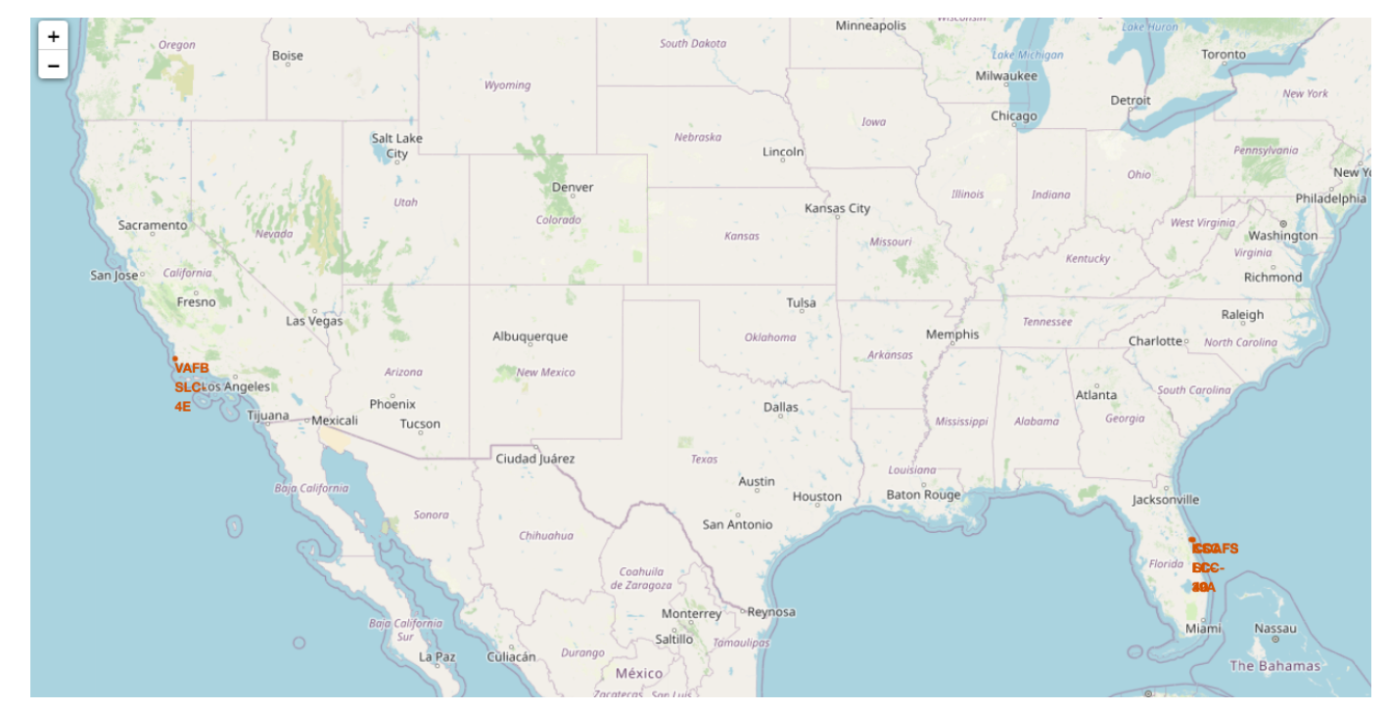
Build an Interactive Map with Folium
Map Markers have been added to the map with aim to finding an optimal location for building a launch site
https://github.com/amrik-mark42/Final-Presentation/blob/main/6.%20lab_jupyter_launch_site_location.jupyterlite.ipynb

Slide 14
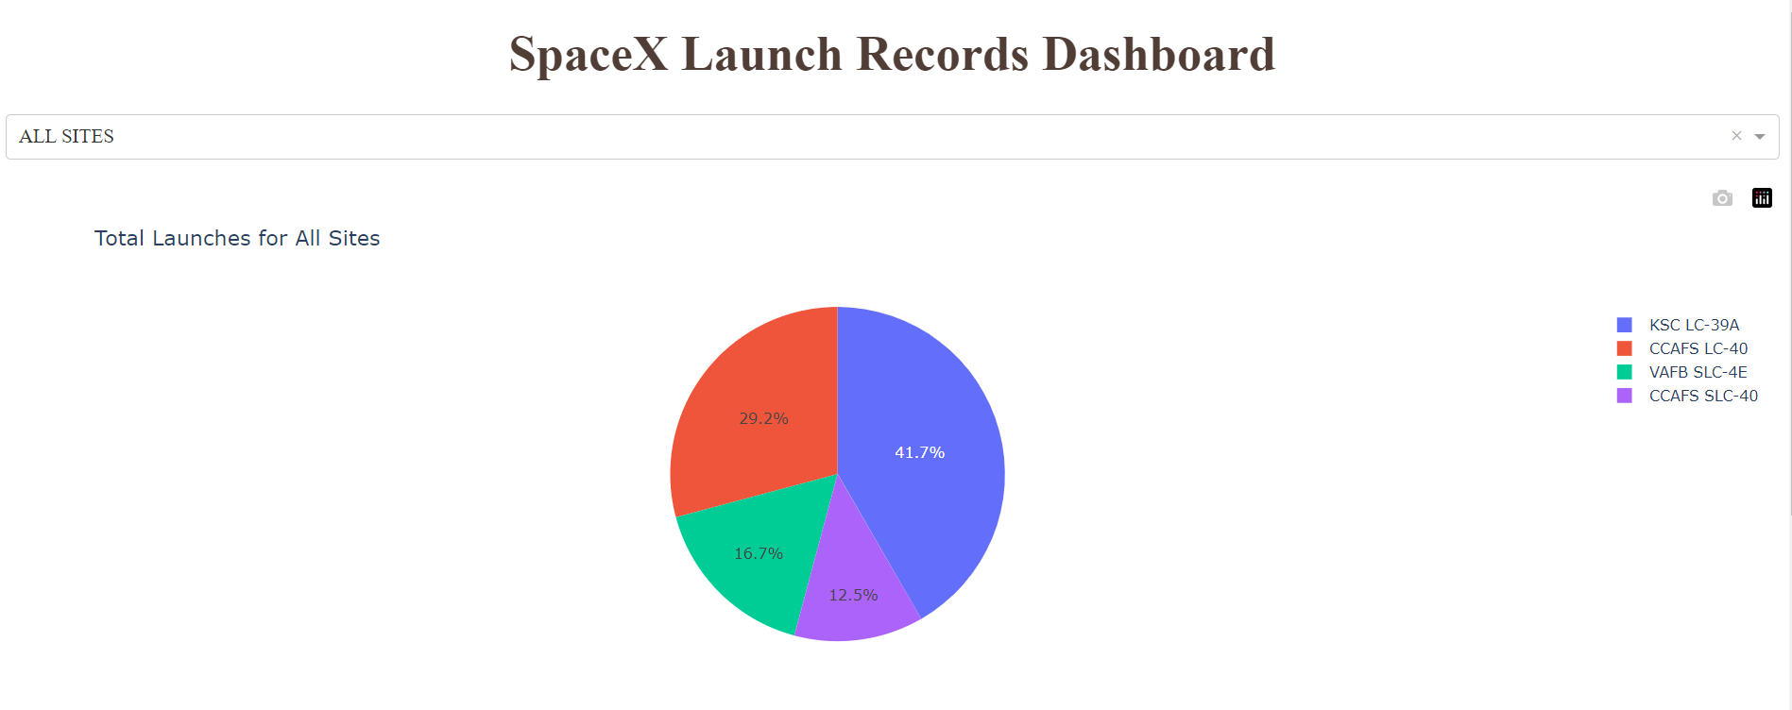
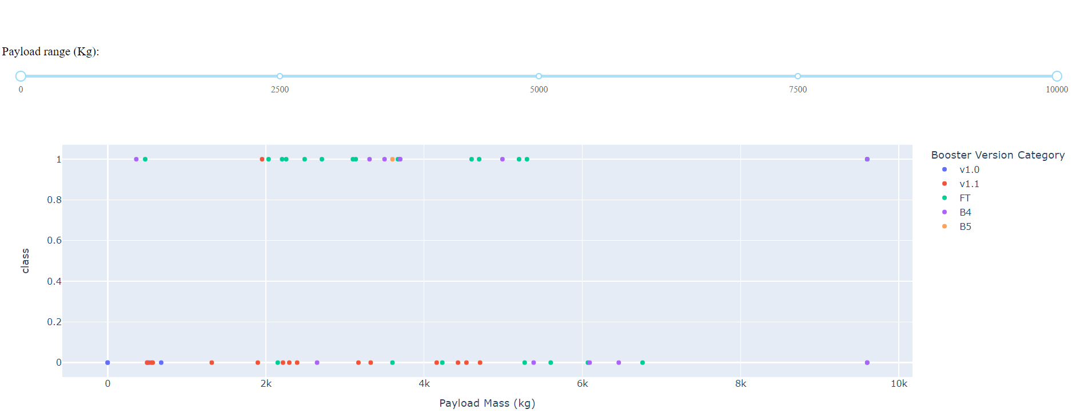
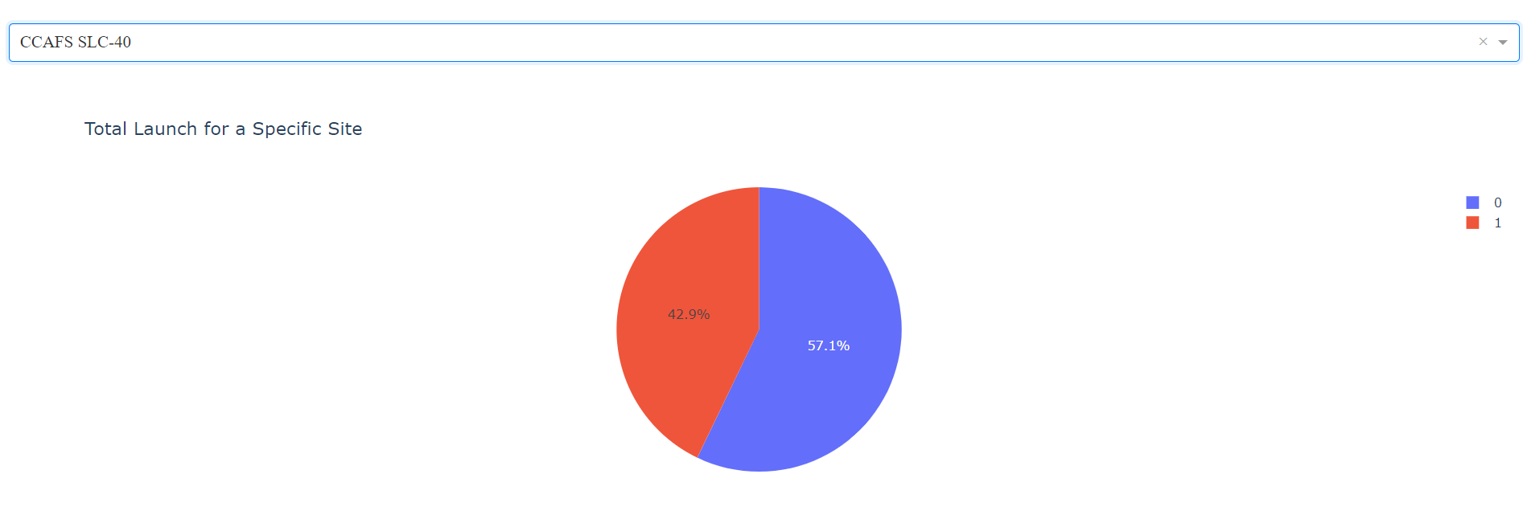
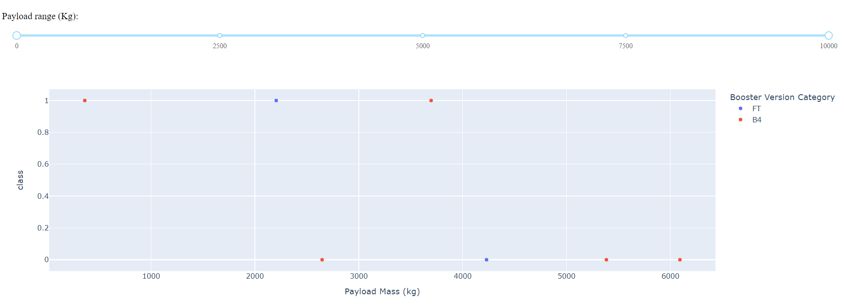
Build a Dashboard with Plotly Dash
https://github.com/amrik-mark42/Final-Presentation/blob/main/7.%20spacex_dash_app.py

Slide 15
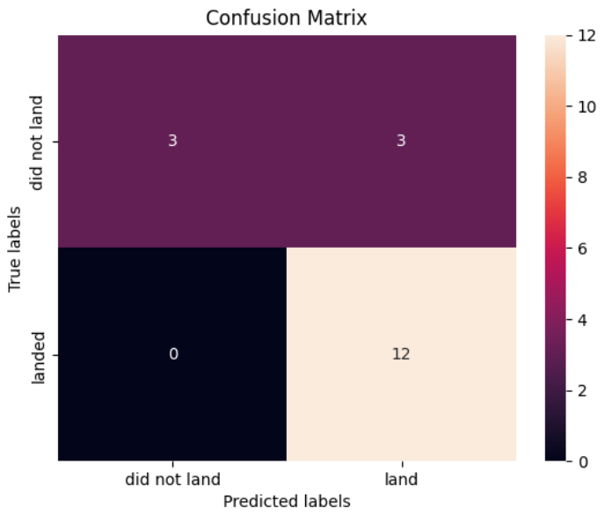
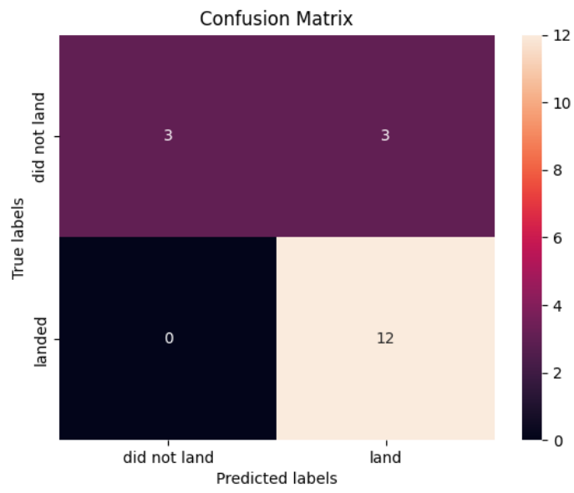
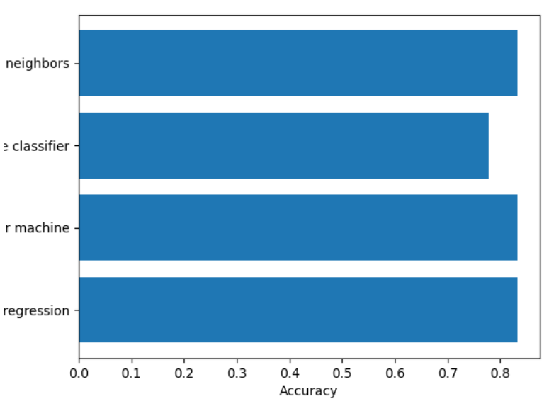
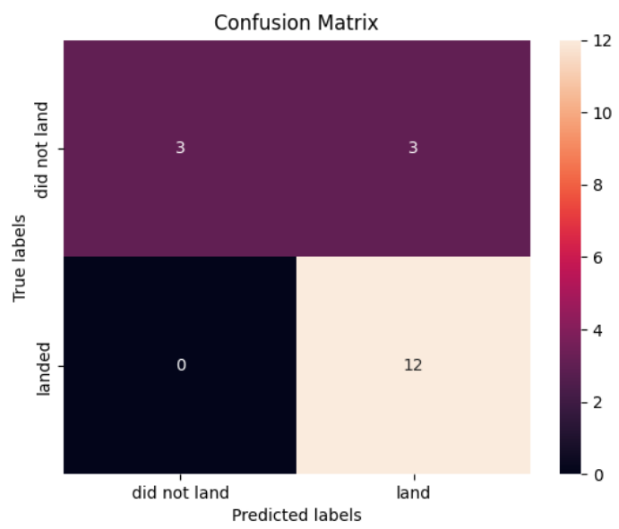
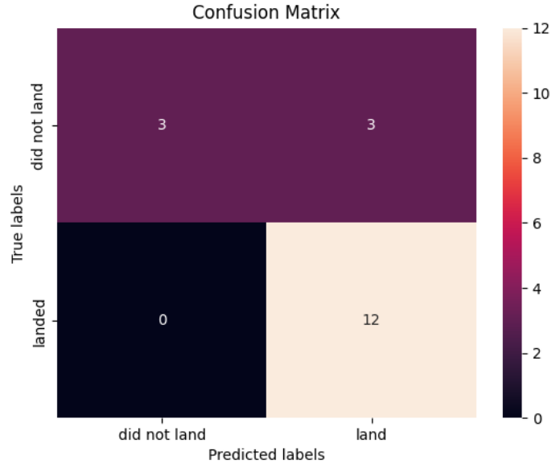
Predictive Analysis (Classification)
The SVM, KNN and Logistic Regression model achieved the highest accuracy at 83.3%, while the SVM performs the best in terms of Area Under the Curve at 0.958.
https://github.com/amrik-mark42/Final-Presentation/blob/main/8.%20SpaceX_Machine_Learning_Prediction_Part_5.jupyterlite.ipynb

Slide 16
Results
The SVM, KNN and Logistic Regression models are the best in terms of prediction accuracy for this dataset.
Low weighted payloads perform better than the heavier payloads.
The success rates for spaceX launches is directly proportional time in years they will eventually perfect the launches.
KSC LC 39A had the most successful launches from all the sites.
Orbit GEO, HEO, SSO, ES L1 has the best Success Rate.

Slide 17

Part 2 Results From EDA

Slide 18
Flight Number vs. Launch Site
Launches from the site of CCAFS SLC 40 are significantly higher than launches from other sites.

Slide 19
Payload vs. Launch Site
The majority of Pay Loads with lower Mass have been launched from CCAFS SLC 40.

Slide 20
Success Rate vs. Orbit Type
The orbit types of ES-L1, GEO, HEO, SSO are among the highest success rate.

Slide 21
Flight Number vs. Orbit Type
A trend can be observed of shifting to VLEO launches in recent years.

Slide 22
Payload vs. Outcome
There are strong relation between Payload Mass and Outcome.

Slide 23
Launch Success Yearly Trend
Launch Success Rate has increased significantly since 2013 and stabilized since 2019.

Slide 24
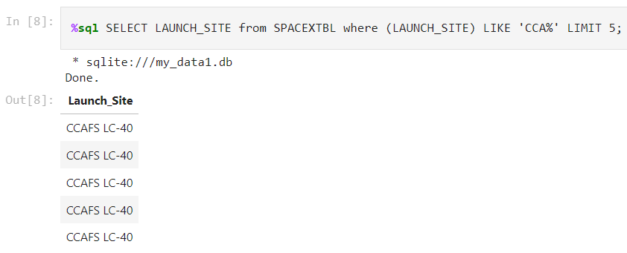
Launch Site Names Begin With ‘CCA’

Slide 25
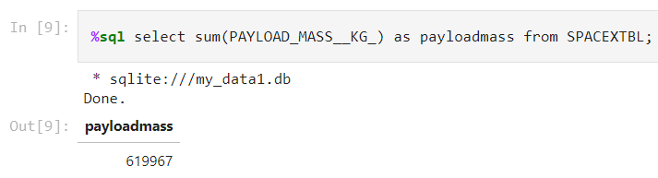
Total Payload Mass

Slide 26
Average Payload Mass by F9 V1.1

Slide 27
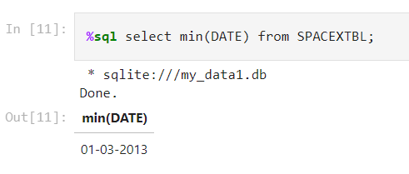
First Successful Ground Landing Date

Slide 28
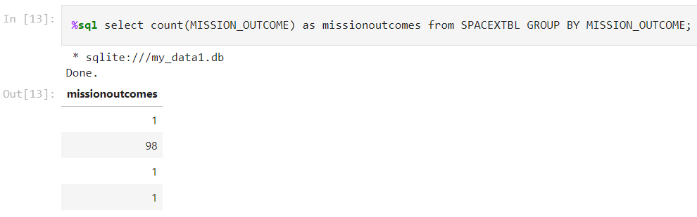
Total Number of Successful & Failure Mission Outcomes

Slide 29
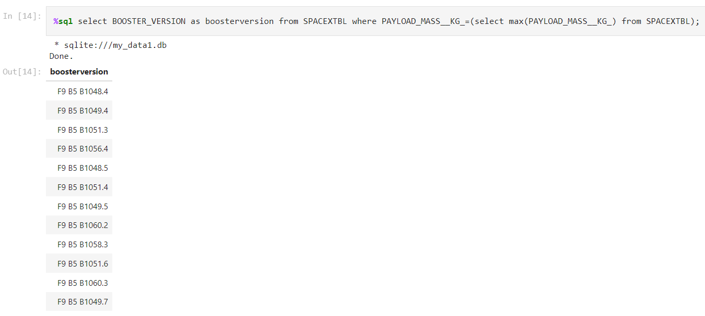
Boosters Carried Maximum Payload

Slide 30

Part 3
Launch Sites Proximities Analysis

Slide 31
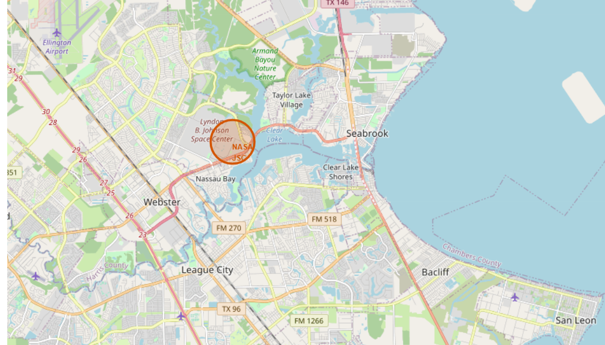
All Launch Sites Marked on a Map

Slide 32
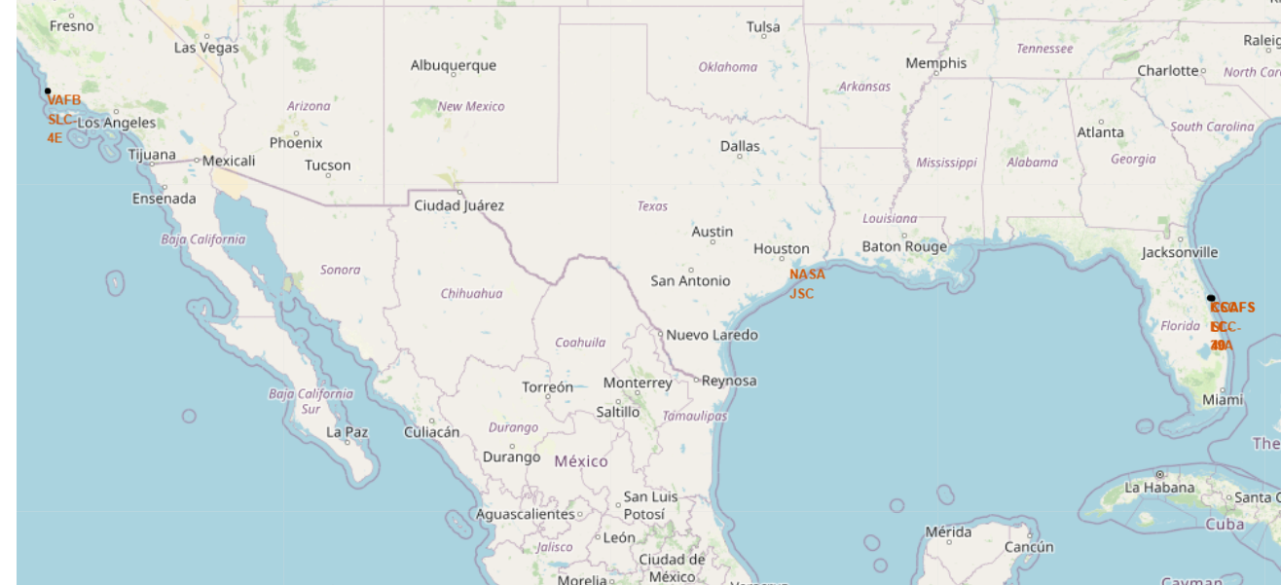
Success/ Failed Launches Marked on the Map

Slide 33
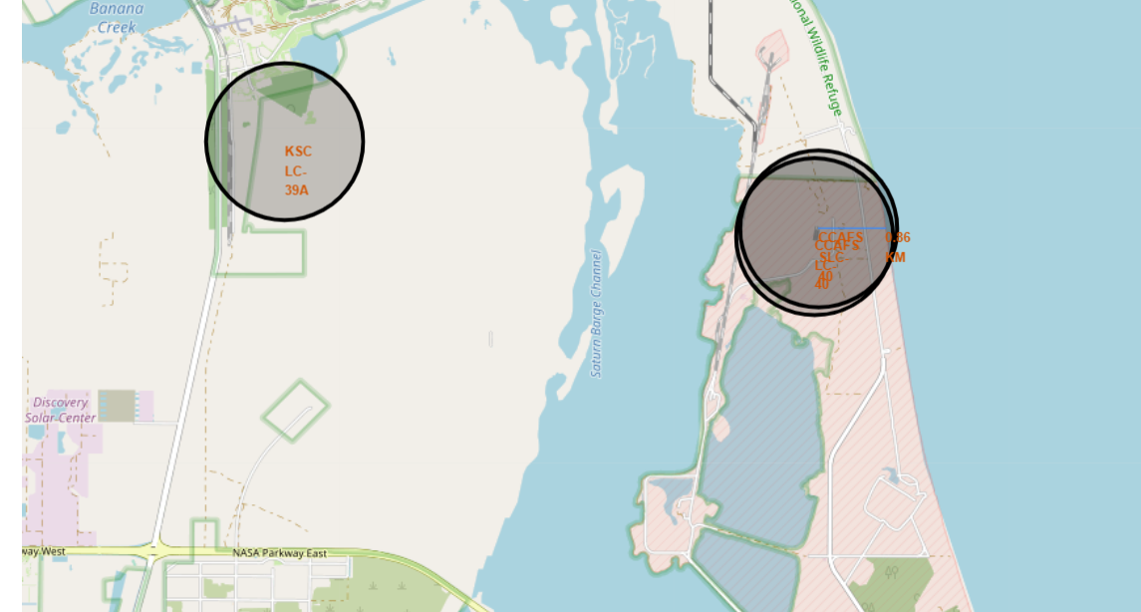
Distances between a Launch Site to its Proximities

Slide 34

Part 4
Build a Dashboard with Plotly Dash

Slide 35
Total Success Launches by all sites

Slide 36
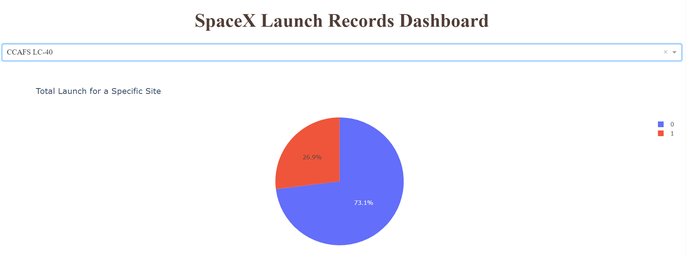
Success Rate by Site

Slide 37
Payload vs Launch Outcome

Slide 38
Part 5
Predictive Analysis (Classification)

Slide 39
Classification Accuracy

Slide 40
Confusion Matrix

Slide 41
Conclusions
The SVM, KNN and Logistic Regression Models are the best in terms of prediction accuracy for this dataset.
Low weighted payloads perform better than the heavier payloads.
The Success rates for SpaceX launches is directly proportional time in years they will eventually perfect the launches.
KSC LC 39A had the most successful launches from all the sites.
Orbit GEO, HEO, SSO, ES L1 has the best Success Rate.

Slide 42
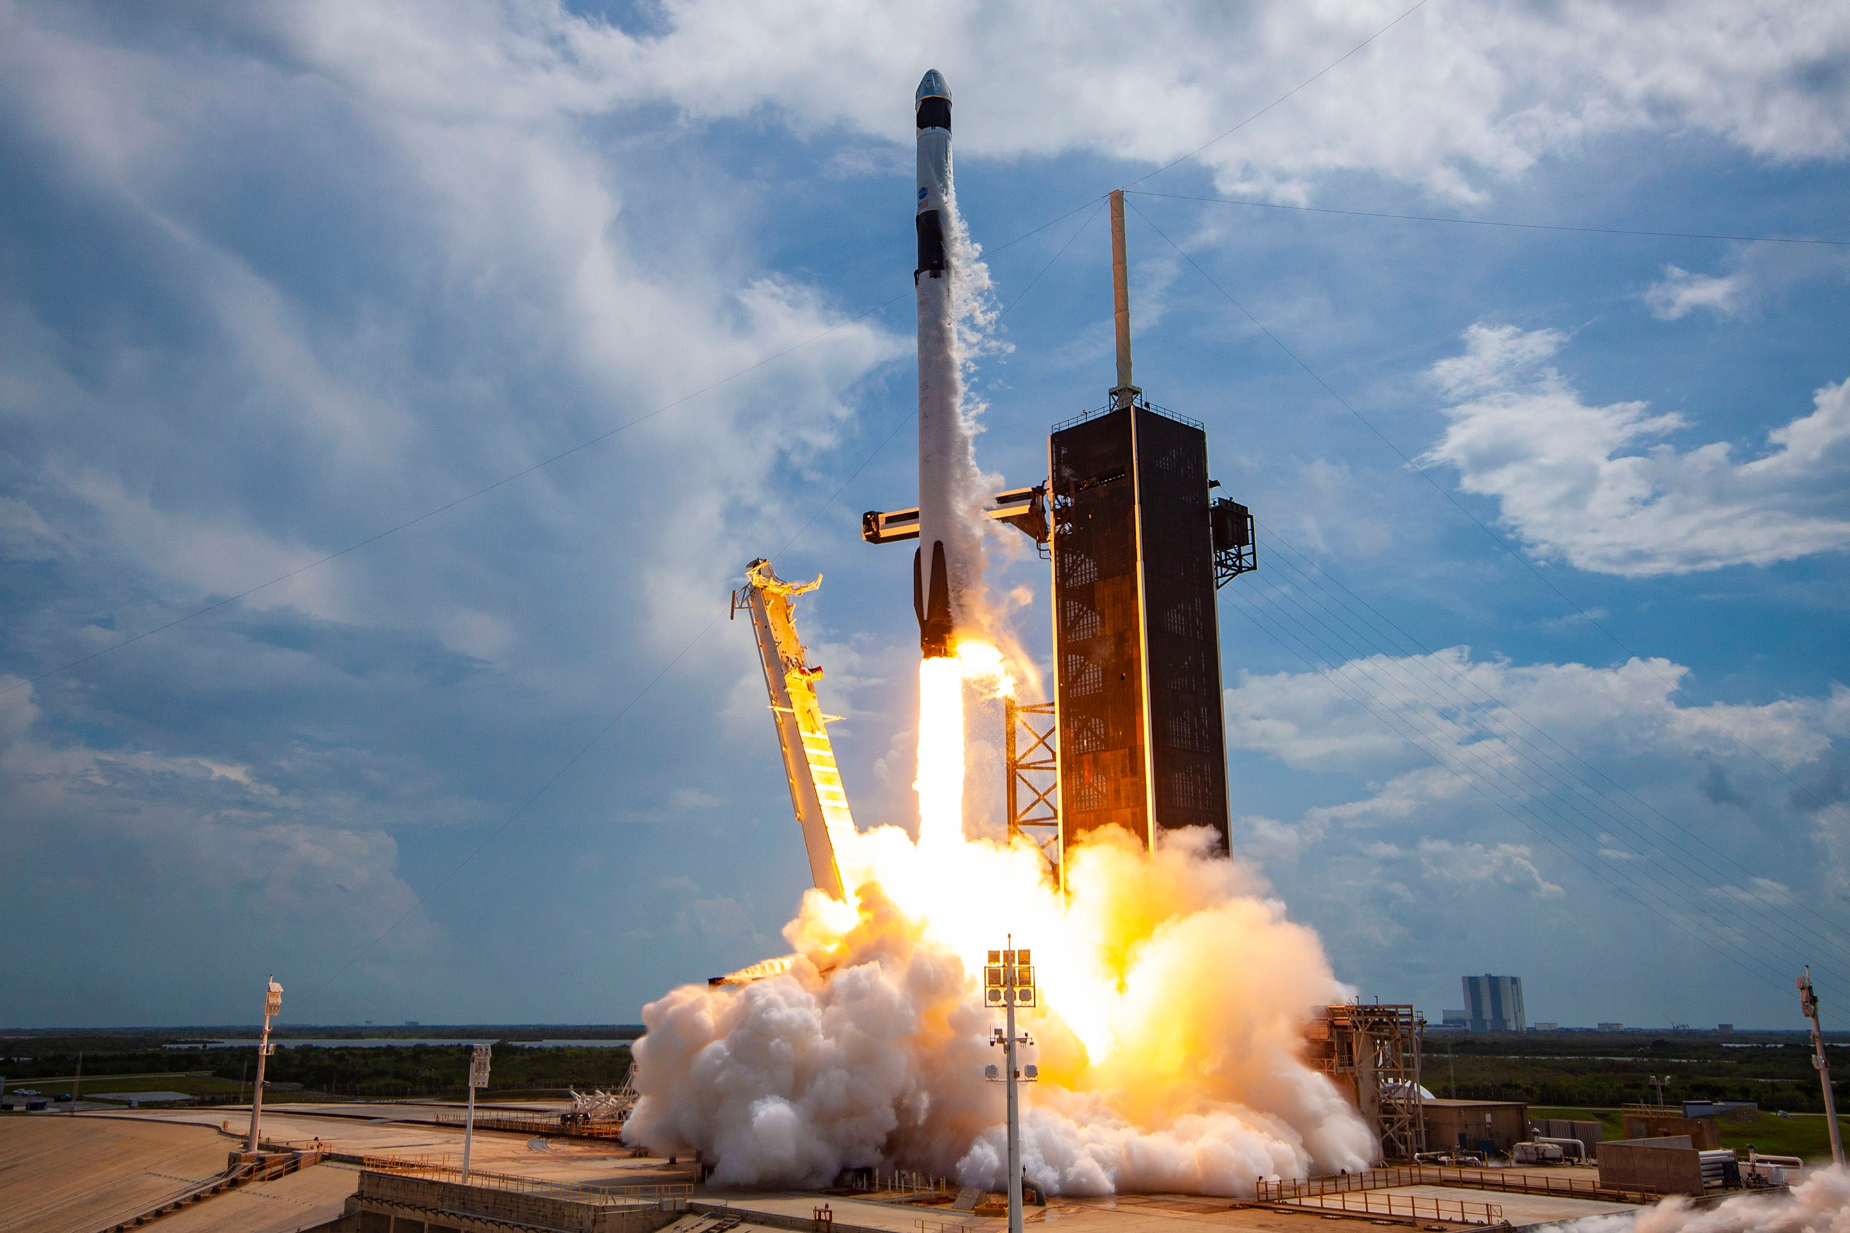
Thank You!

